Slide 1
caArray User Community Meeting
2.0 Release and Next Steps
Call in: 877-416-5524
Participant Passcode: 2627056
Centra: http://ncicb.centra.com
Meeting ID: array_feb6
February 6, 2008

Slide 2
Agenda
2.0 Release
  Features
  Known issues
  Data migration
Release planning
  2.0.1
  2.1.0

Slide 3
caArray 2.0 Release
caArray 1.6 was released on November 30, 2007
In Production at NCICB and code available via
  GForge: https://gforge.nci.nih.gov/projects/caarraydev/
  NCICB Download Center: http://ncicb.nci.nih.gov/download/downloadcaarray.jsp
If you have an earlier version of caArray, we strongly recommend you upgrade to 1.6
  Update installer available to upgrade your Portal instance

Slide 4
1.6 >> 2.0 transition
The NCICB production instance of caArray 1.6 will be ultimately be converted to read-only
1.6 will be kept up for at least 6 months – longer if needed by the community
Data from 1.6 will be migrated to 2.0
  1.6 Experiments URLs will be supported in 2.0 so that external references are maintained
  Experiment Annotations will be exported into MAGE-TAB and Imported into 2.0 along with data files
  For local installers of caArray who want to migrate their data, support will be provided by the caArray team

Slide 5
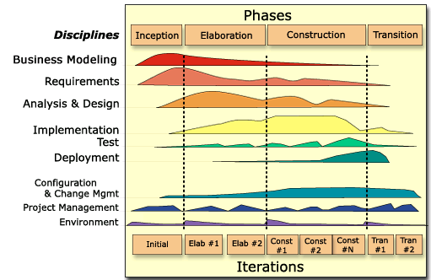
caArray 2.0 - Where We Are
2.0 Transition 2
  caArray 2.0 is feature complete
  Model registration process is underway
  End user documentation is in process
  GUI Installer is being created

Slide 6
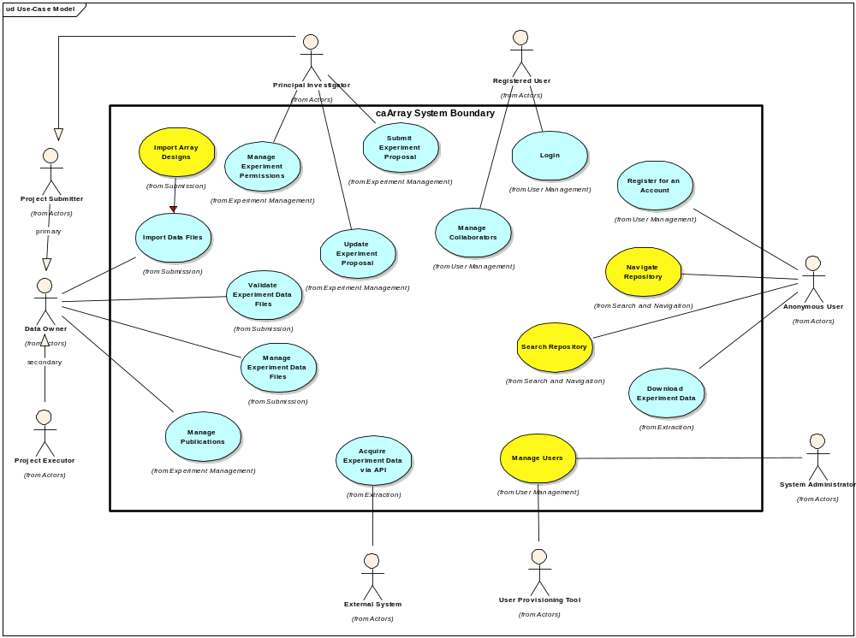
Use Cases Implemented

Slide 7
caArray 2.0 Release Status
GA Production release date has been moved to January 25, 2008
  To allow additional time for testing and bug fixes
  To complete documentation
Release is the focus of intensive QA and bug fixes
  6 dedicated testers plus more….
  57% of identified bugs fixed (140/244)
  Recent work focused on performance improvements for Upload, Validate, Import
caArray 2 will be part of the Life Sciences Distribution, to be released in Q1, 2008
  https://cabig.nci.nih.gov/getting_connected/working_with_cabig/

Slide 8
MAGE-TAB Workshop
NCICB will be hosting a MAGE-TAB Workshop January 24-25, 2008
Agenda and registration available at:
  http://guest.cvent.com/EVENTS/Info/Summary.aspx?e=111cbdb5-08fa-4cd2-8e8c-bc74ed3250ad
The goal of the workshop is to gather requirements and use cases from the community using or planning to use the MAGE-TAB specification.

Slide 9
Live Demonstration
Walkthrough of critical use cases
  Navigate and Search Repository
  Login and Create an Experiment
    Experiment States – Draft, In Progress, Public
    Walk through of UI Experiment Concepts
  Validate Data
  Import Array Data
    Import MAGE-TAB Data
    Import Supplemental Data
  Import an Array Design
  Manage Collaborators
  Manage Permissions

Slide 10
Key documents for reference
caArray Vision Document
  https://gforge.nci.nih.gov/svnroot/caarray2/trunk/docs/requirements/caarray_vision.doc
caArray 2.0 Scope Document
  https://gforge.nci.nih.gov/svnroot/caarray2/trunk/docs/requirements/caarray_scope_2_0.doc
caArray 2.0 Use Case Specifications
  https://gforge.nci.nih.gov/svnroot/caarray2/trunk/docs/requirements/use_cases
caArray 2.0 Software Architecture Document
  https://gforge.nci.nih.gov/svnroot/caarray2/trunk/docs/analysis_and_design/caarray_software_architecture_document.doc
caArray Domain Model (IE Only)
  https://gforge.nci.nih.gov/svnroot/caarray2/trunk/docs/analysis_and_design/models/html/caarray_client_model/index.htm
caArray Installation Guide
  https://gforge.nci.nih.gov/svnroot/caarray2/trunk/docs/deployment/auto-remote-deploy/caarray2-installation-instructions.doc
Slides from past Users Meetings
  https://gforge.nci.nih.gov/svnroot/caarray2/trunk/docs/project_management/open_meetings

Slide 11
Continuing Engagement Model
Continue Monthly Meetings
Work directly with Cancer Centers for Installation Support and Feature Elicitation and Prioritization for what we should focus on next
G-Forge site for 2.0 is available that indicates needs, features, use cases, test cases and defects
G-forge site: https://gforge.nci.nih.gov/projects/caarray2/

Slide 12
Next Steps
Please visit GForge: https://gforge.nci.nih.gov/projects/caarray2/ to view the prioritization of features, use cases (Tracker items), links to critical documents (Docs Tab)
Next meeting date: TBA – will be moving to a regular schedule

